Slide 1

Passengers on Flight the Database
By: Chevroen Washington

Slide 2
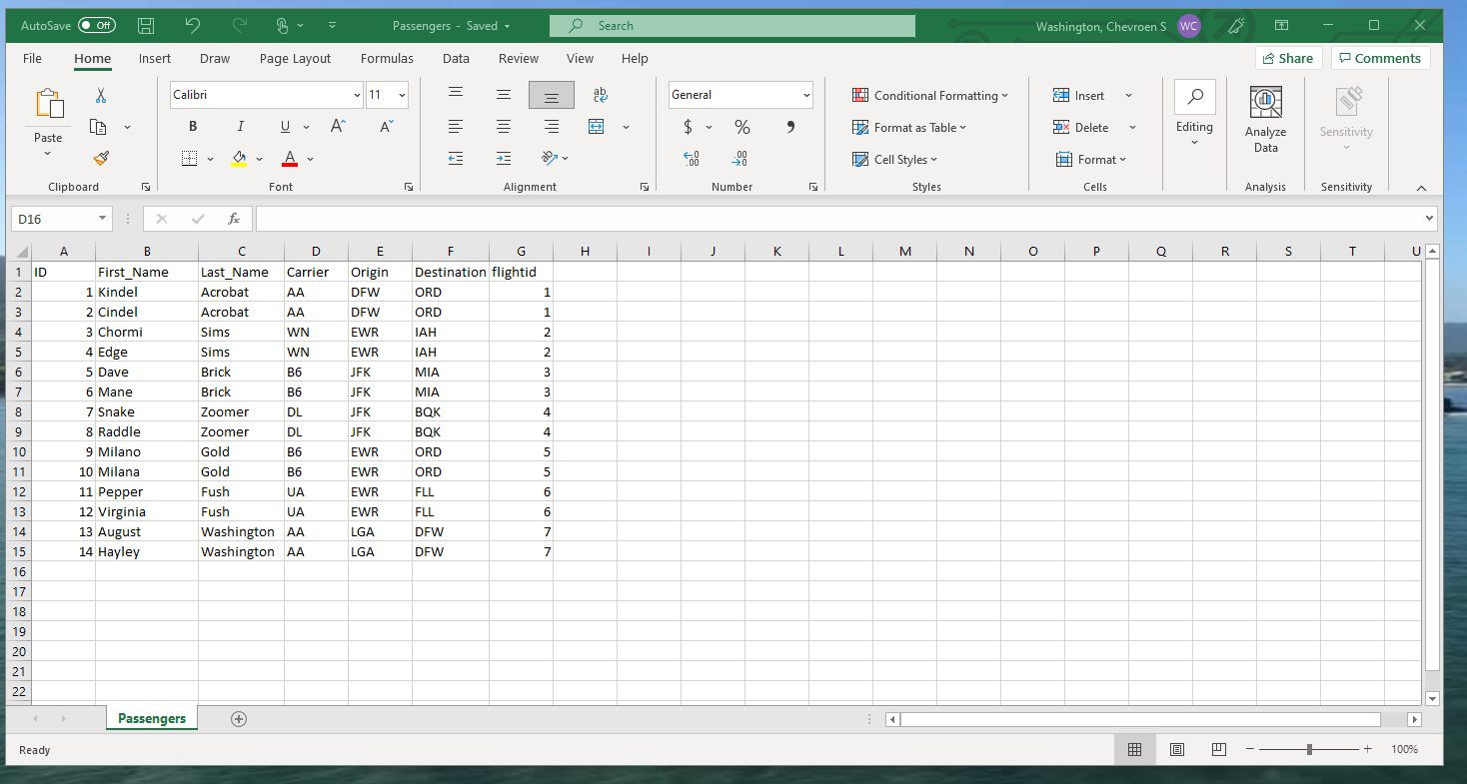
Step 1: Creation of the Passenger File
Based on the flights in the flights file
There are two passengers for each flight
The carrier column was included

Slide 3
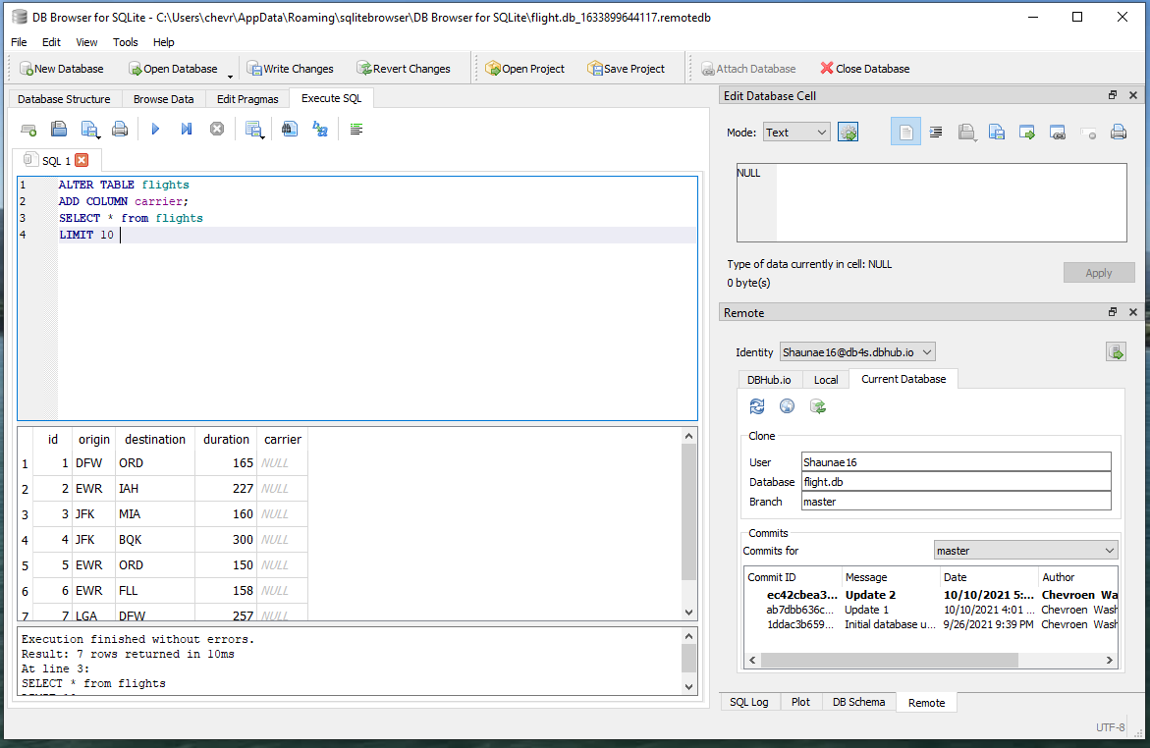
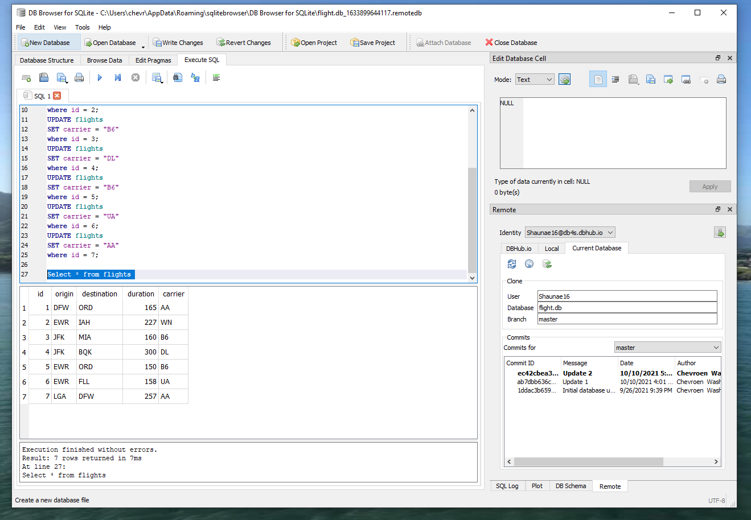
Step 2: Add Carrier Column to flights
Creation of carrier column in the flights table
Insert of the carrier data based on flight id

Slide 4
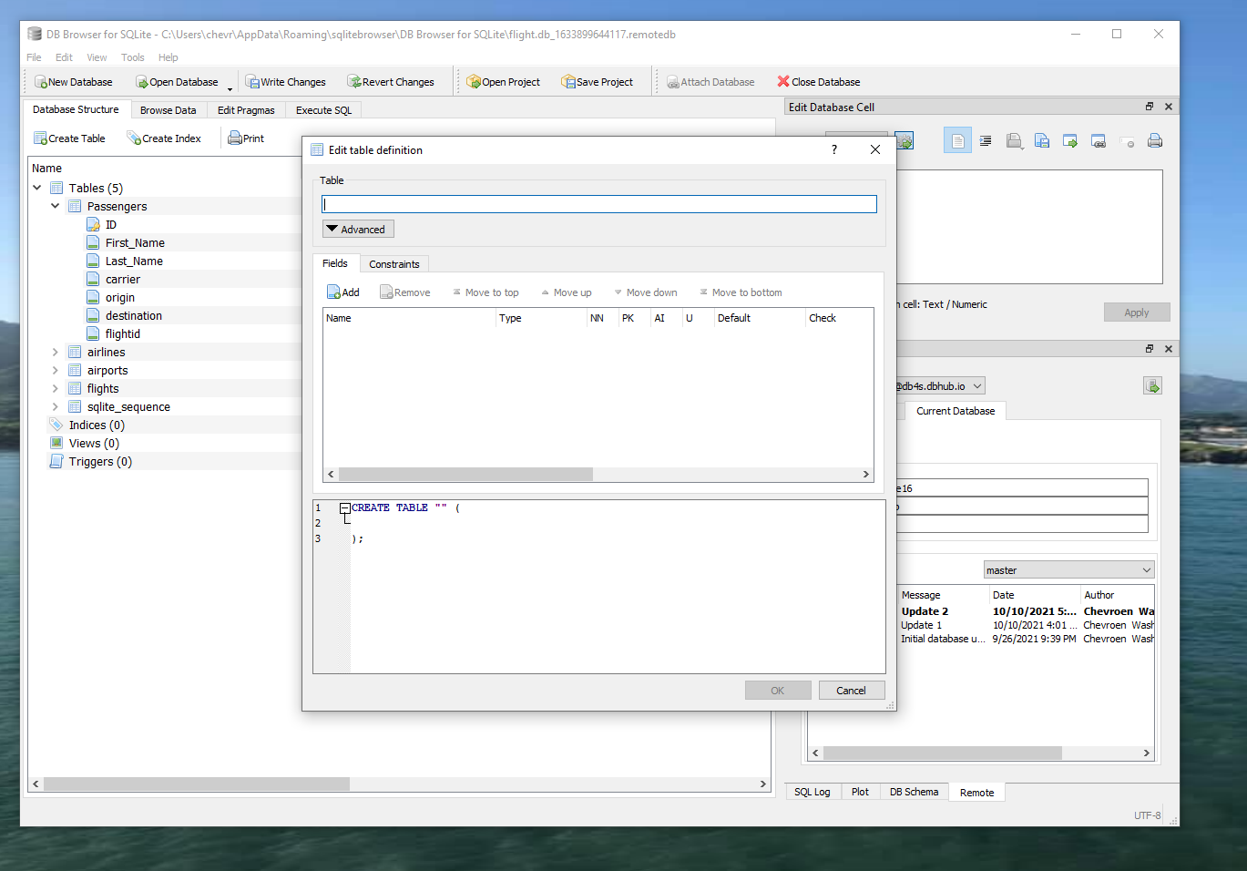
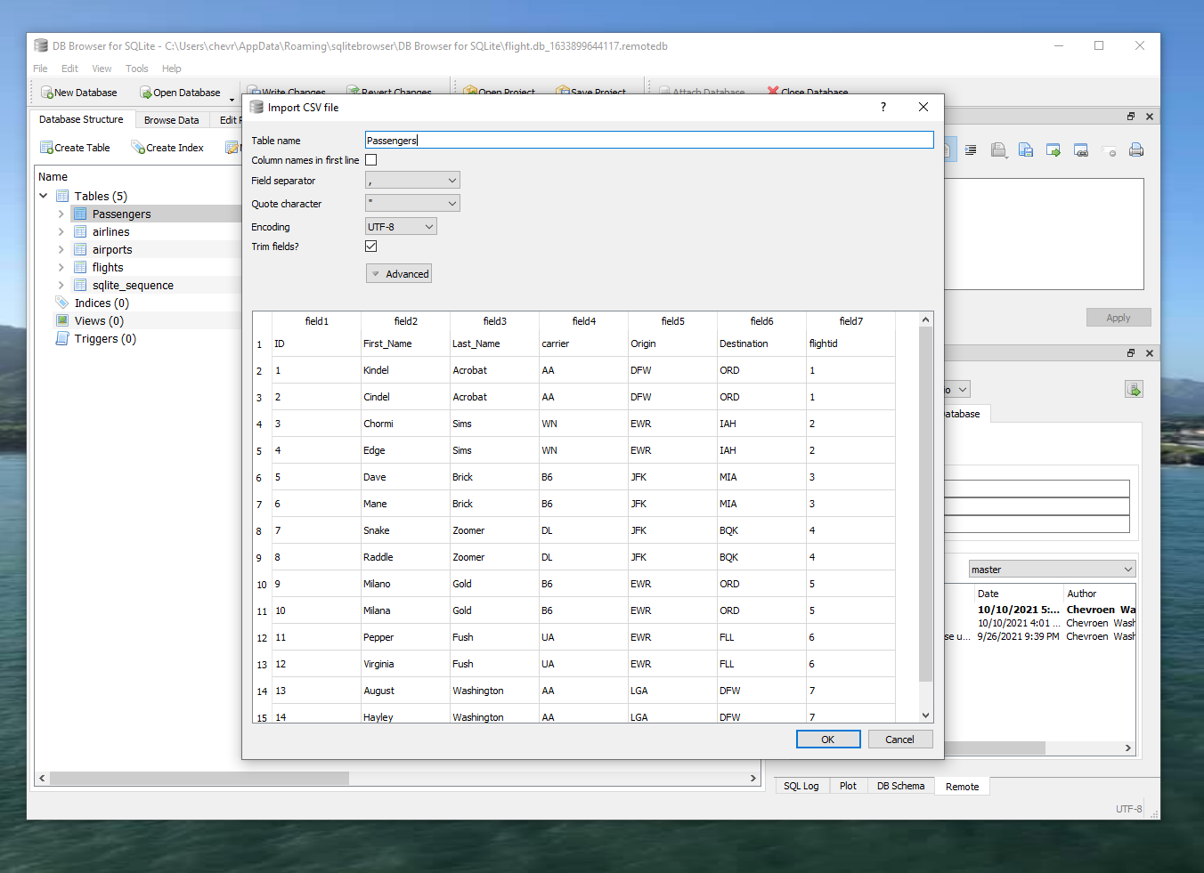
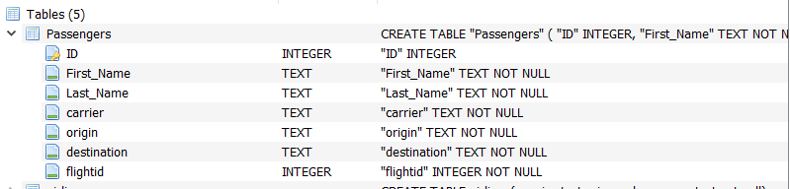
Step 3: Create Passengers table

Slide 5
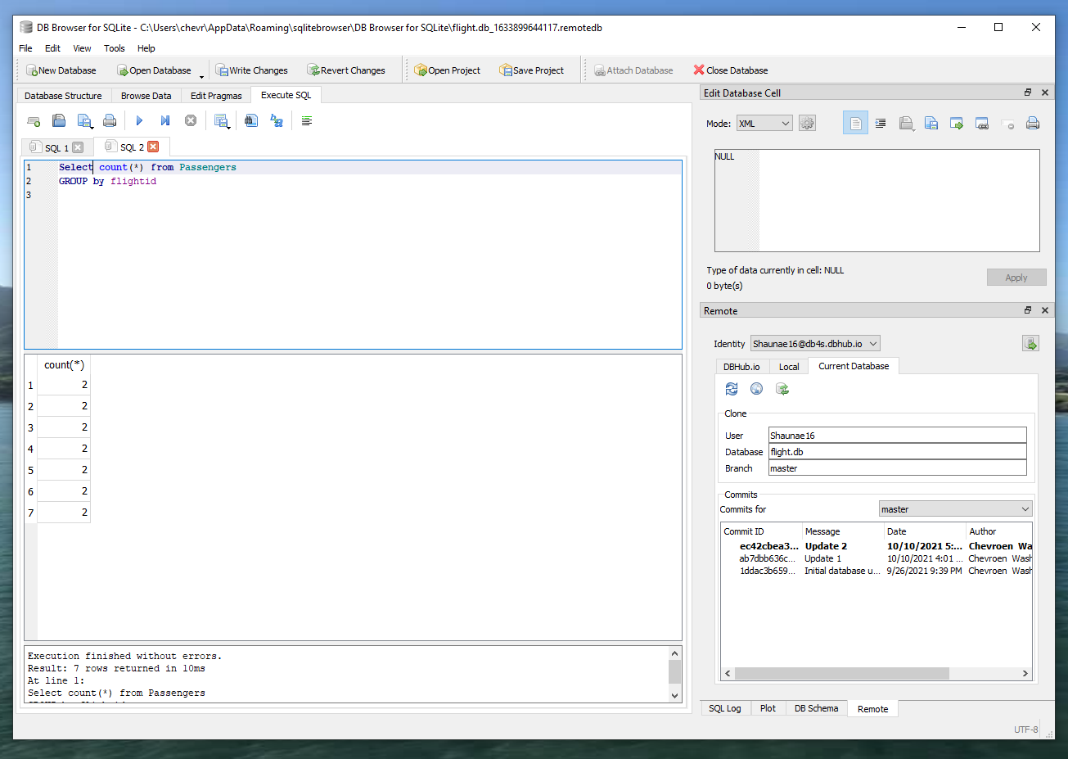
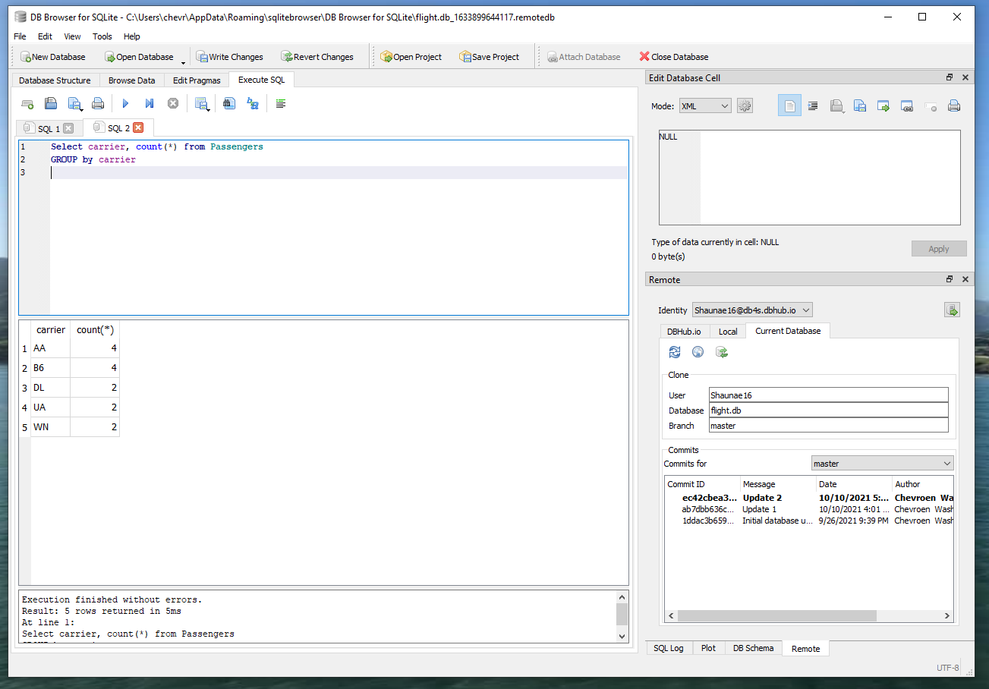
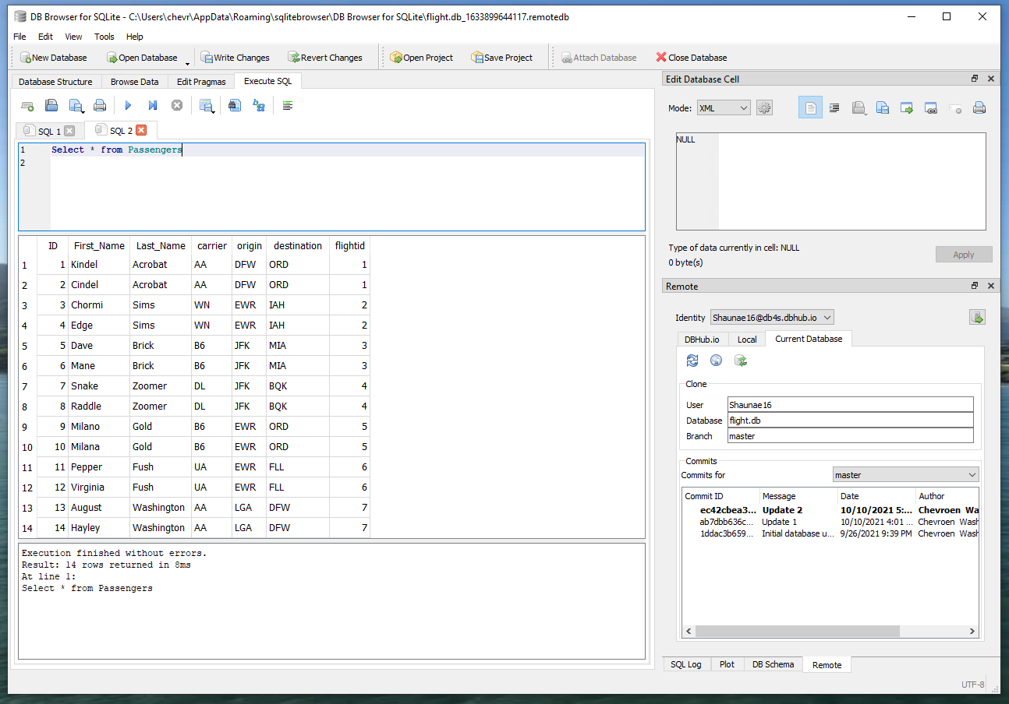
Step 4: Query the Passengers
Count all
Select all
Group by carrier

Slide 6
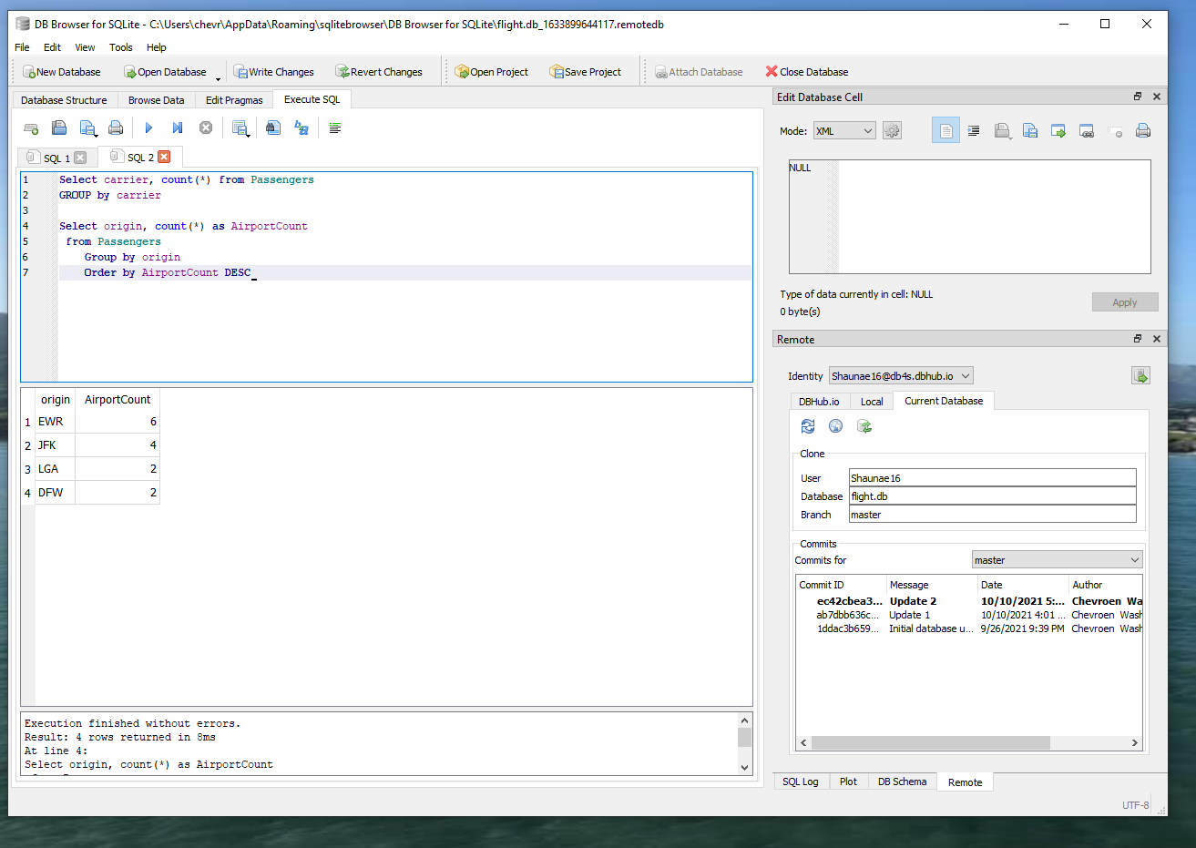
Step 4: Continued
Count of Passengers
by Origin
Count of Passengers
by Top 3 Origin

Slide 7
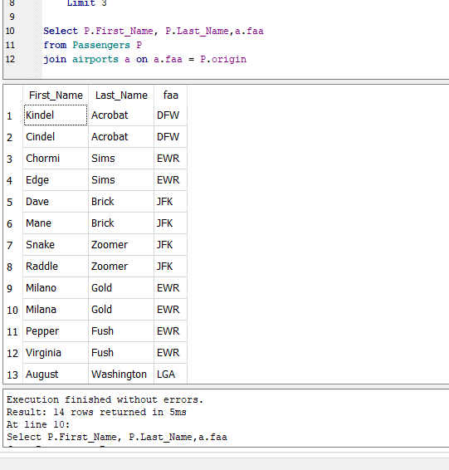
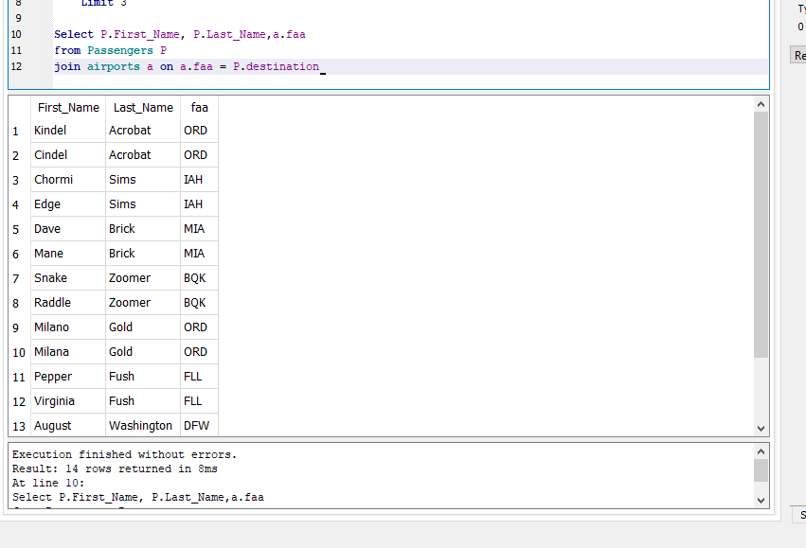
Step 5: Joins to Passenger
Passenger names and their origin airport
Passenger names and their destination airport

Slide 8
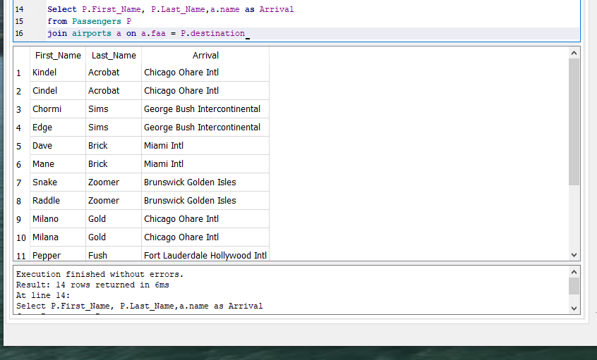
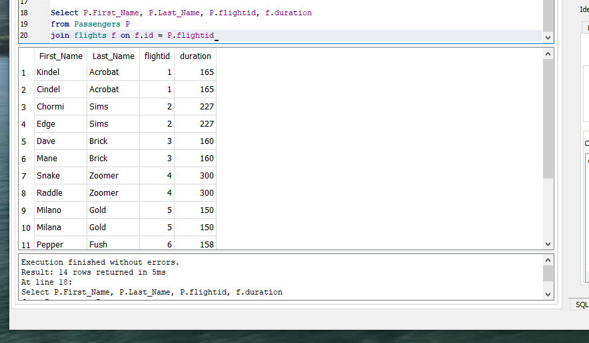
Step 5: Continued…
Passengers with the names of their destination airport
Passengers with the duration of their flights

Slide 9
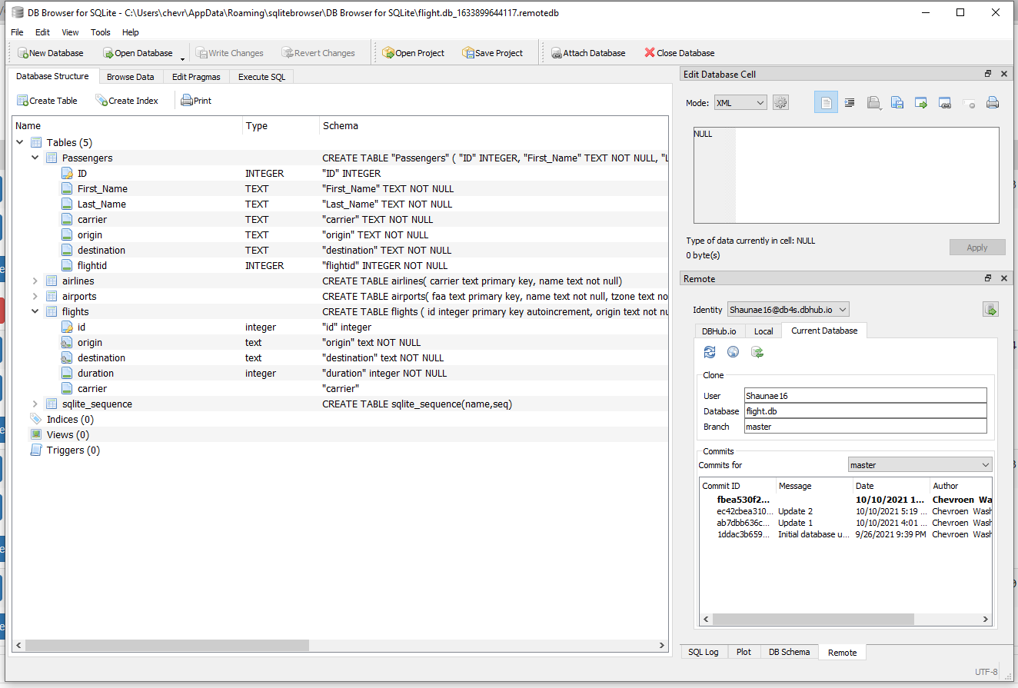
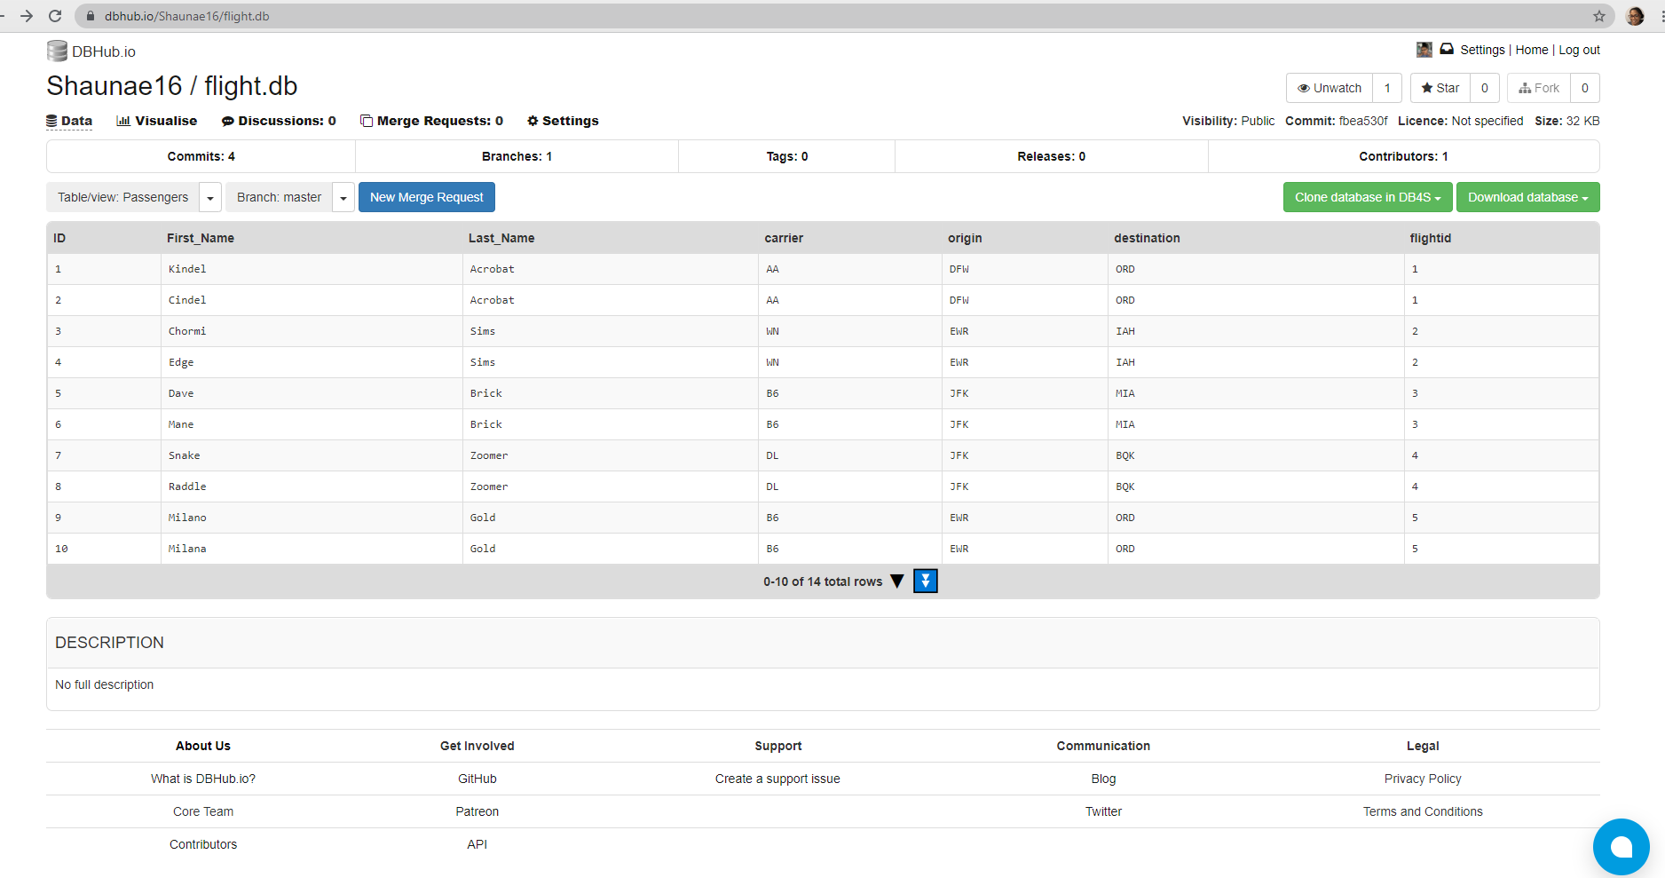
Step 6: Update DBHub
Commit from local
Passengers are public

Slide 10
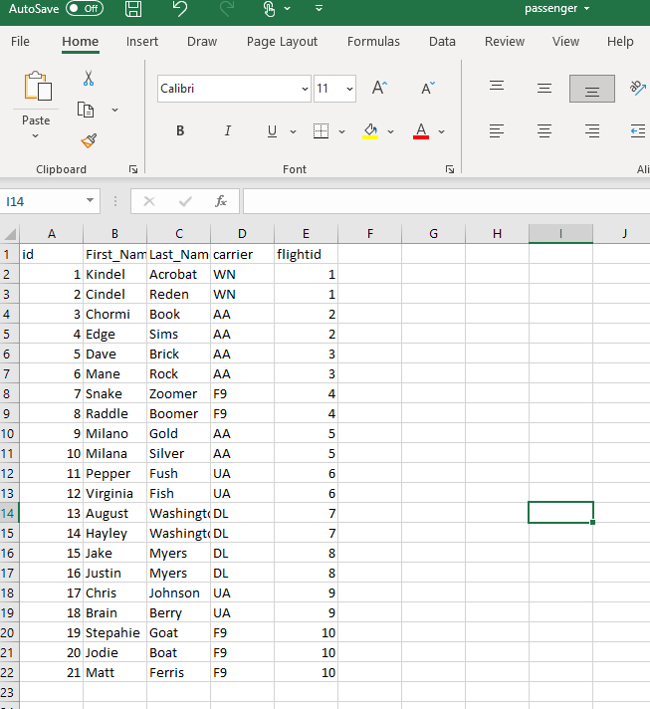
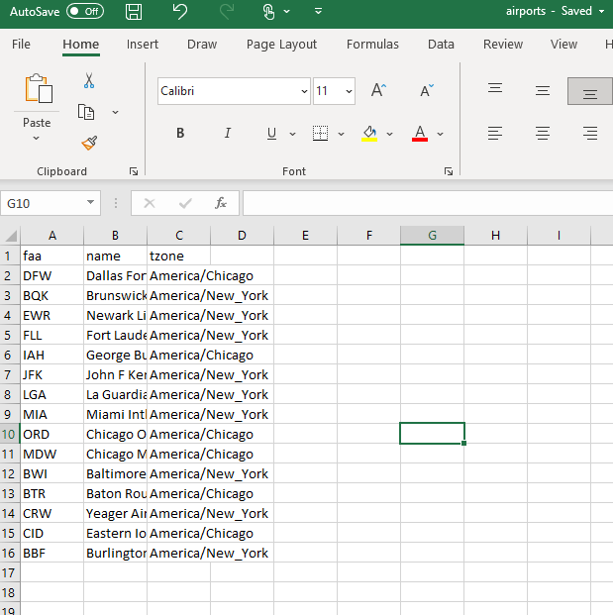
Creation of New Database: Step 1
Make new files

Slide 11
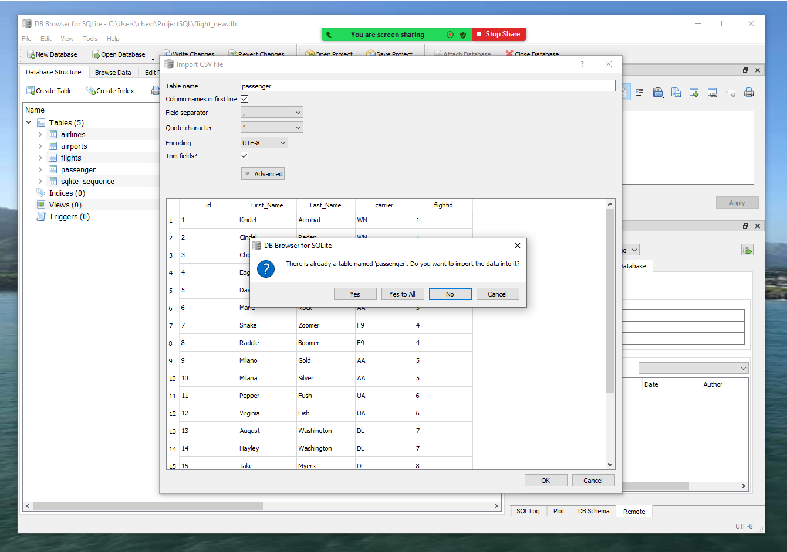
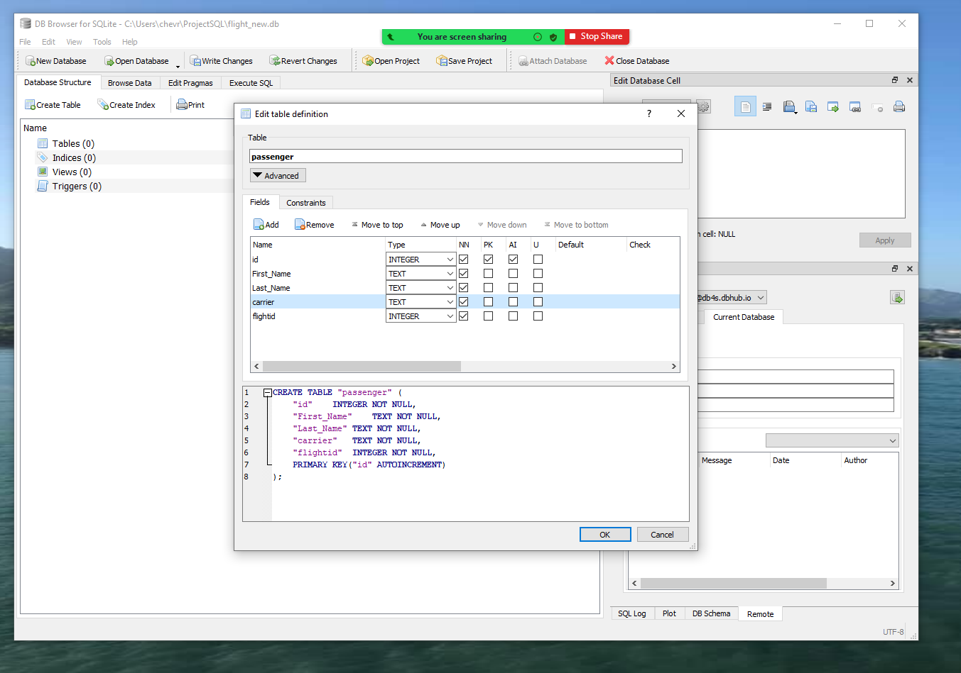
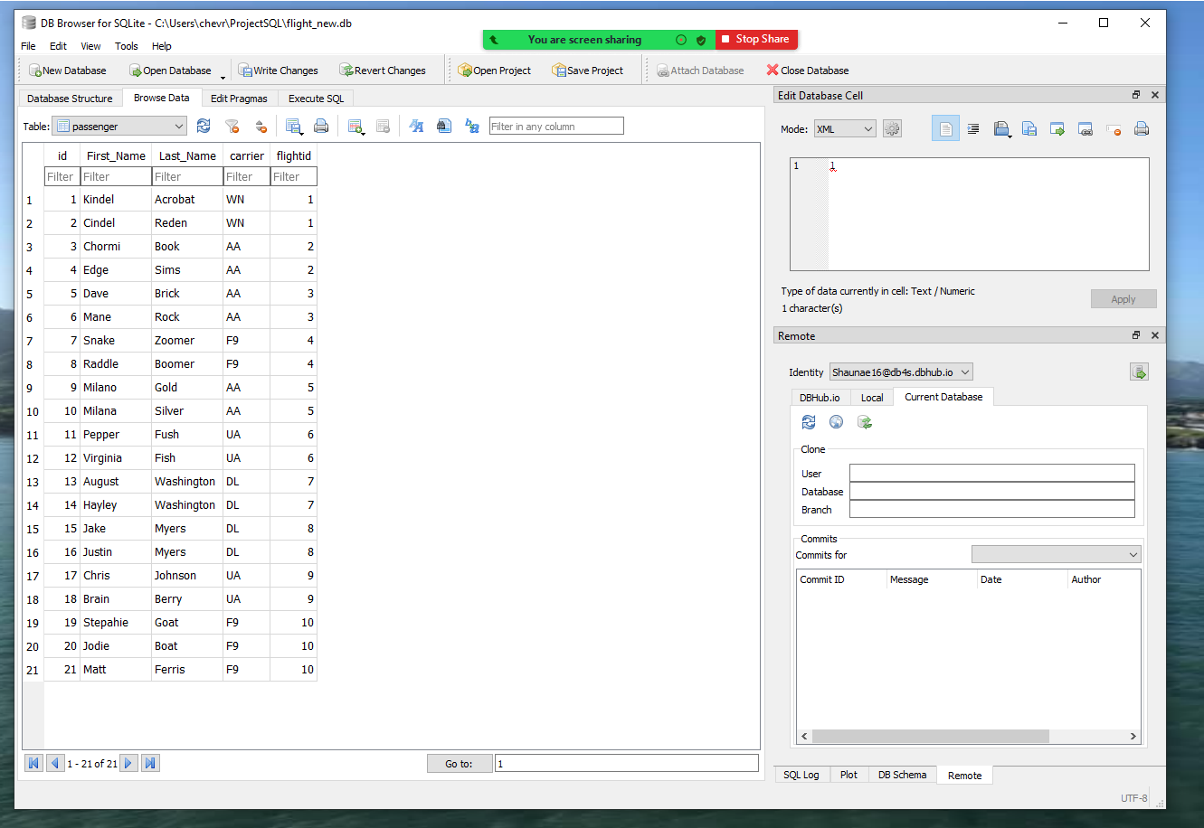
Step 2: Make tables

Slide 12
Step 3: Watch the video
Database Creation by Chevroen
Uploaded to Github Separately

Slide 13
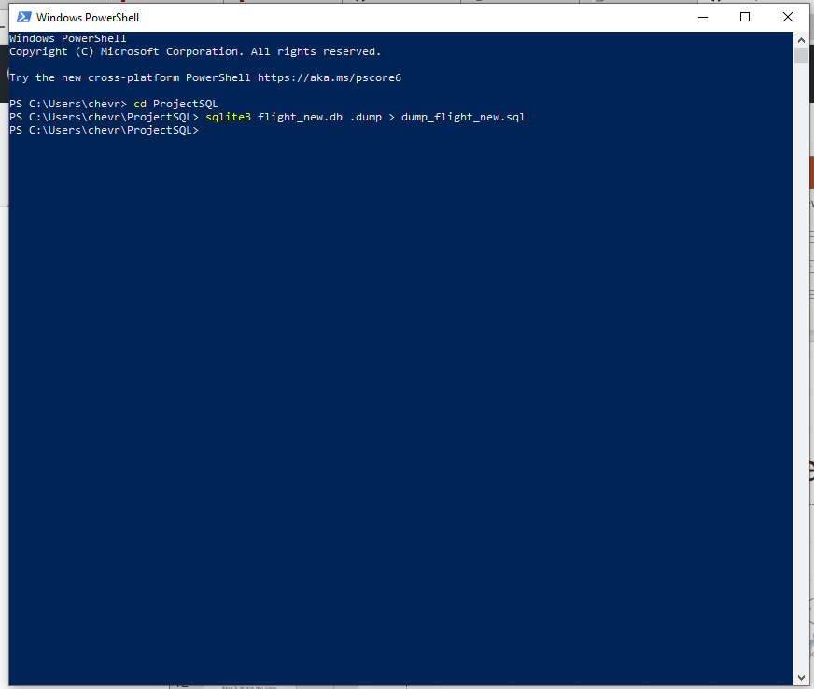
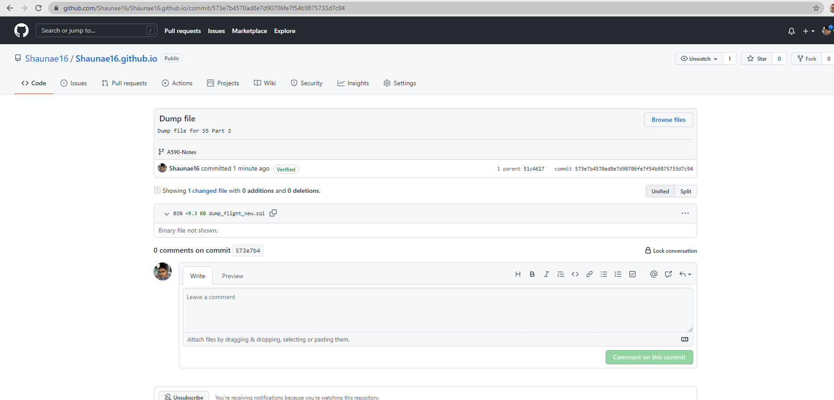
Step 4: Dump file & share SQL

Slide 14

The End. Questions?

